Slide 1
Plan
“Data Scientists spend up to 80% of the time on data cleaning and 20 percent of their time on actual data analysis”
-- ?????
Tidy Data (a way to organize data)
Data manipulation (a continuation)
summarise() and group_by()
_join() datasets
Again, we will focus on basics, underlying principles, and best practices

Slide 2
So you want to be a data scientist…

Slide 3
How will you spend your time?

Slide 4
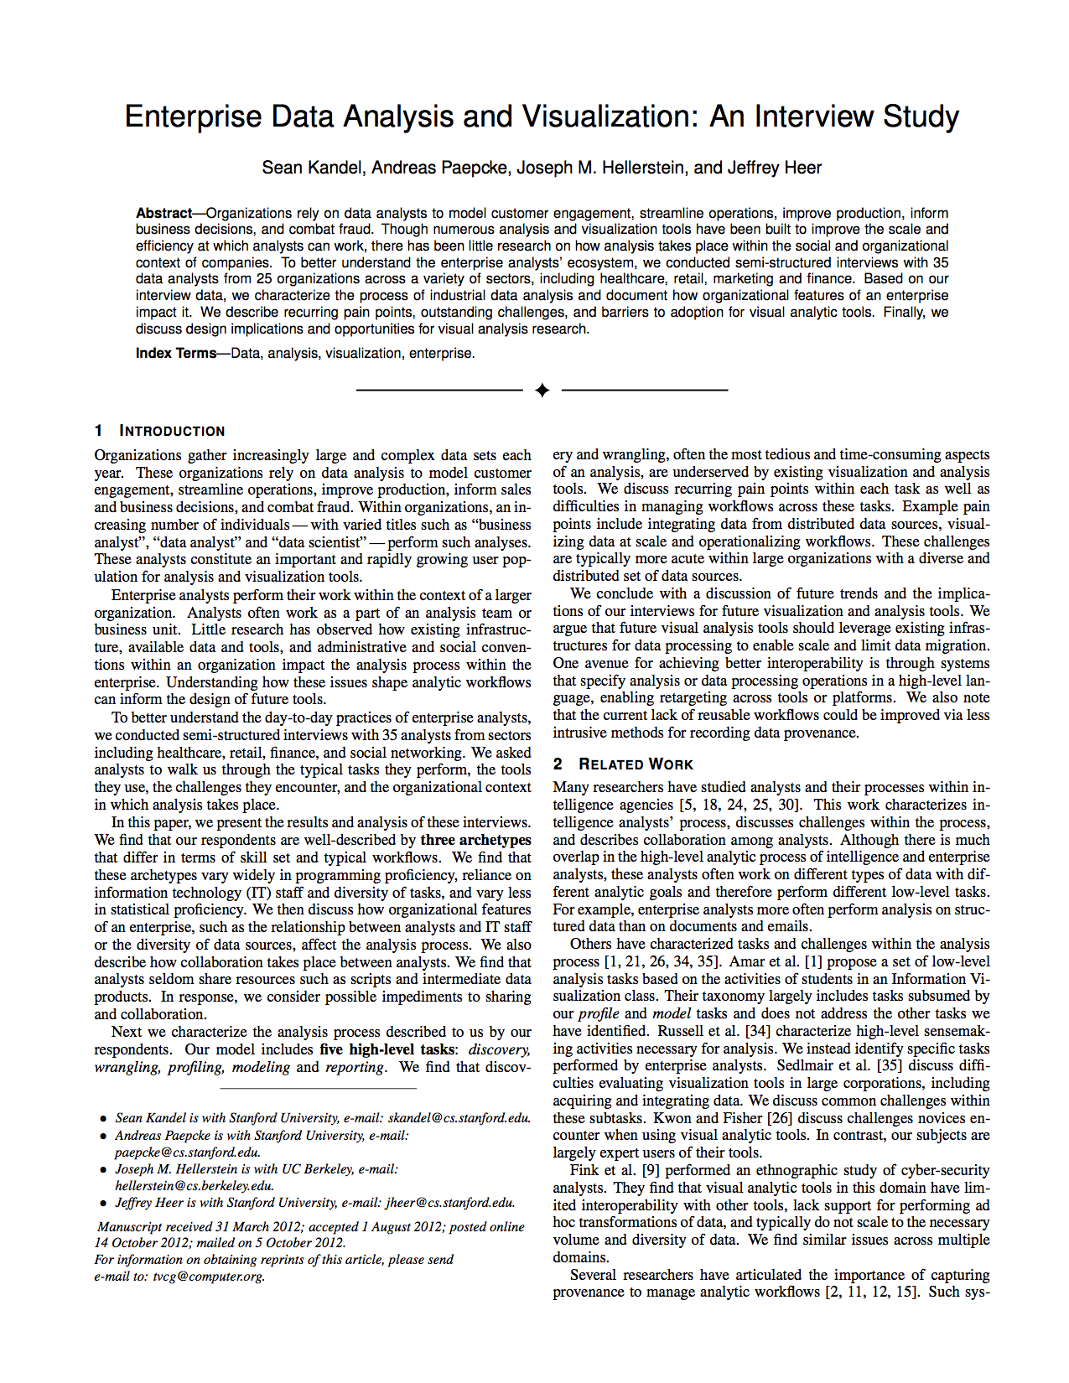
Enterprise Data Analysis and Visualization: An Interview Study
Interview study of 35 analysts
Various titles
Data analyst
Data scientist
Software engineer
Consultant
Chief technical officer
25 companies
Healthcare
Retail, Marketing
Social networking
Media
Finance, Insurance
Kandel et al. “Enterprise Data Analysis and Visualization: An Interview Study. IEEE Visual Analytics Science & Technology (VAST), 2012
http://db.cs.berkeley.edu/papers/vast12-interview.pdf
Notes:
----- Meeting Notes (10/29/14 17:37) -----
FINISH ME!

Slide 5
“I spend more than half of my time integrating, cleansing and transforming data without doing any actual analysis. Most of the time I’m lucky if I get to do any ‘analysis’ at all…
… Most of the time once you transform the data ... the insights can be scarily obvious.”

Slide 6
“Once you play with the data you realize you made an assumption that is completely wrong. It’s really useful, it’s not just a waste of time, even though you may be banging your head.”
“In practice it tends not to be just data prep, you are learning about the data at the same time, you are learning about what assumptions you can make.”

Slide 7
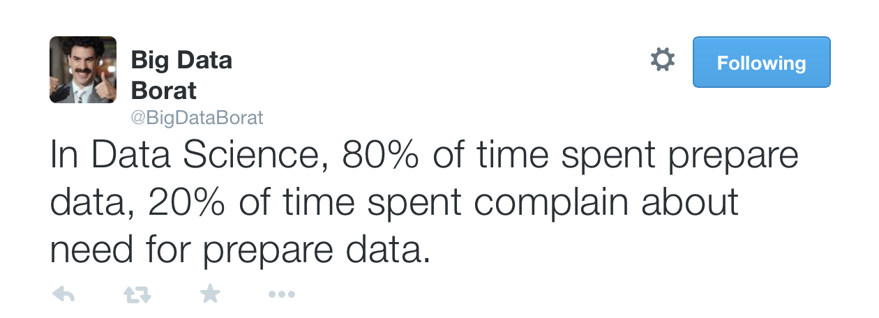

Slide 8

Data Wrangling
Aka Data Prep, Data Munging, Data Transformation
Assessing and transforming raw data to make it fit for use
That depends!
Fit for what use?

Slide 9
Data Wrangling
Aka Data Prep, Data Munging, Data Transformation
Assessing and transforming raw data to make it fit for use
This is how you “get your head in the game”
Understand what you have
Assess strengths and weaknesses of your data
Hypothesize about what to do with your data
Get it ready
Nobody will know your data as well as you do while wrangling
Not even the “you” of a few days later

Slide 10
Discussion
When is data “dirty”?
How does that happen?
Notes:
Many possibilities here for discussion
Outliers
Misspellings
Type/constraint violations
Inconsistencies
Duplication
Missing data
Unusual distributions
Wrong granularity
Wrong time or other scope
Data entry
Measurement error
Bad data integration
Poor experimental design
Mismatch of data to task

Slide 11
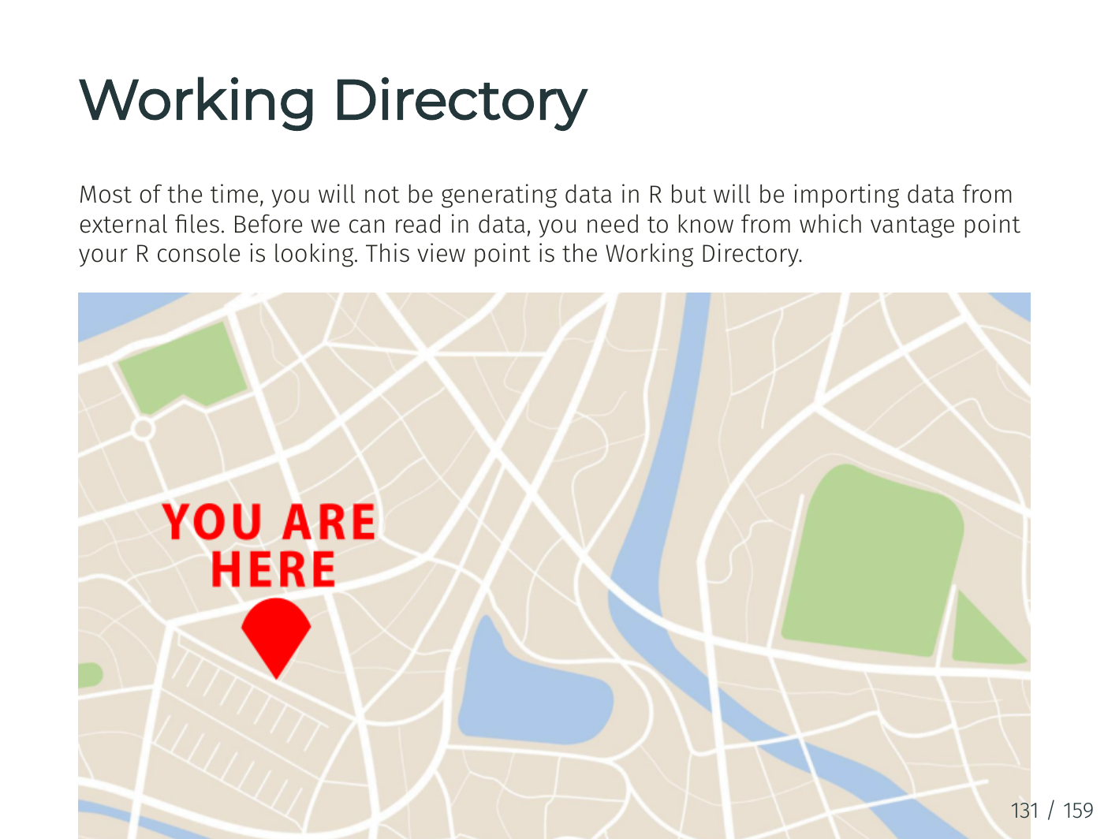

Slide 12
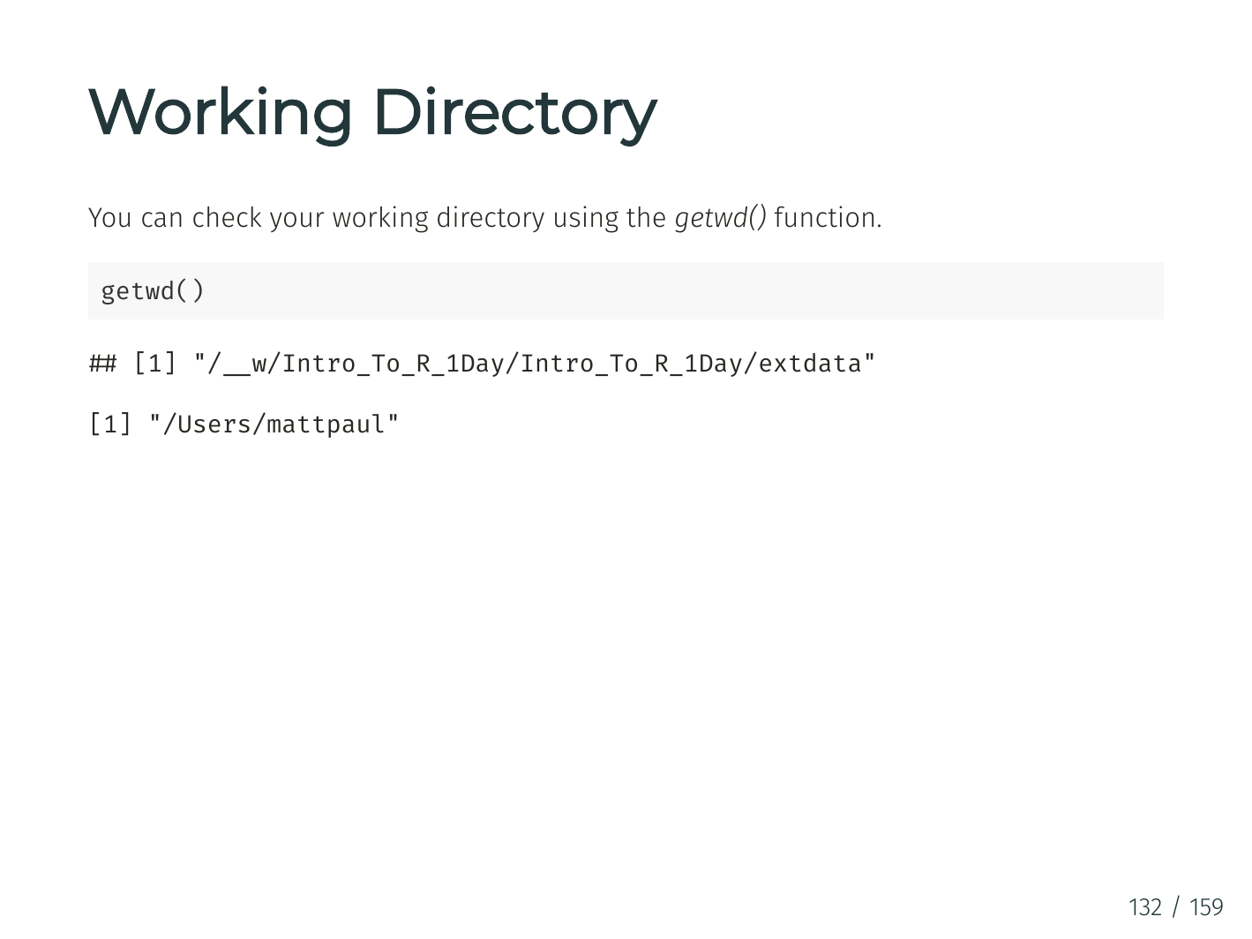

Slide 13
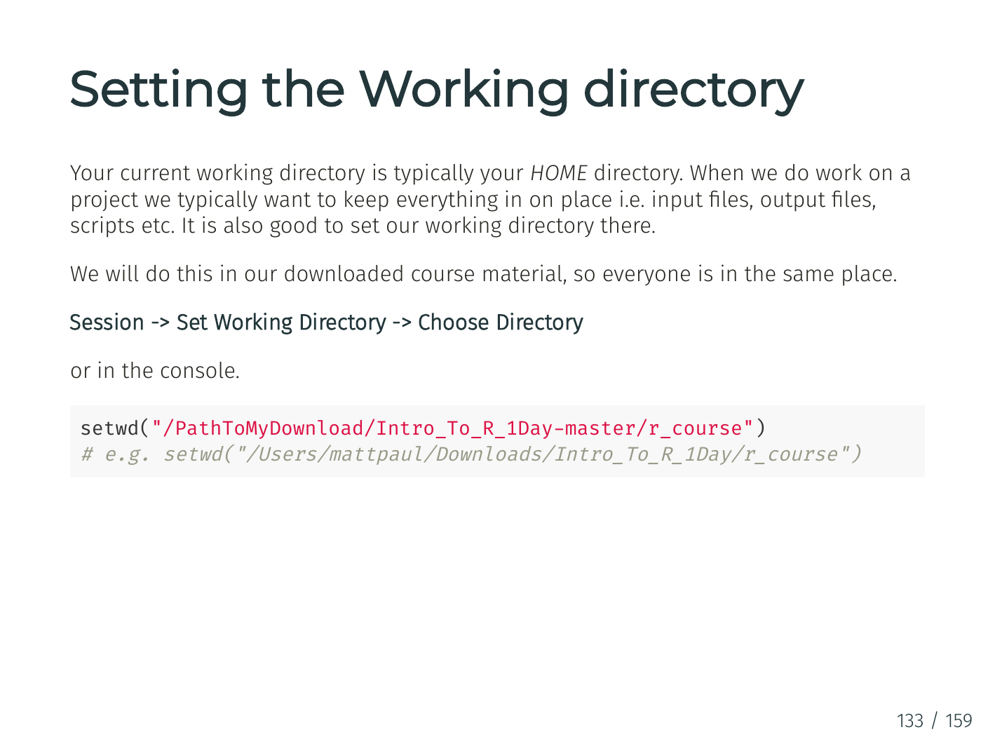

Slide 14
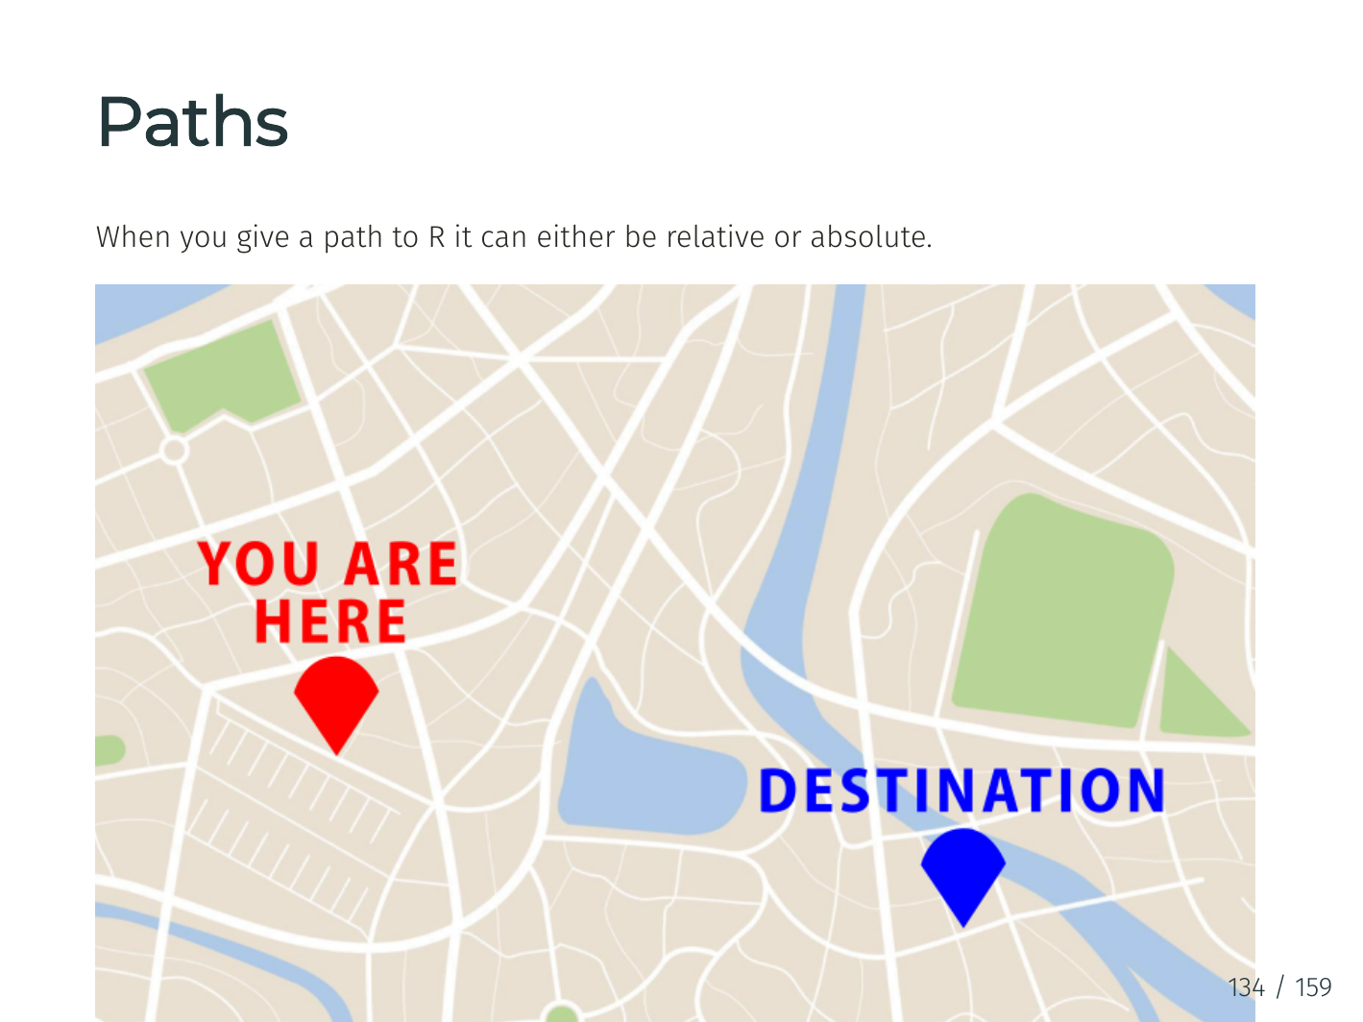

Slide 15
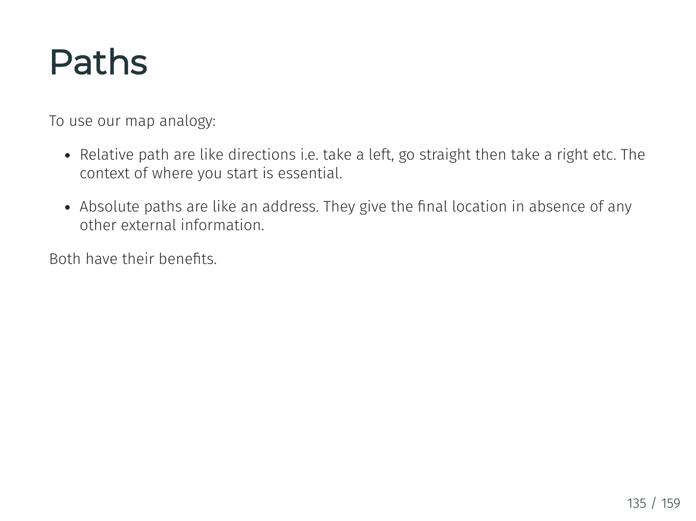

Slide 16
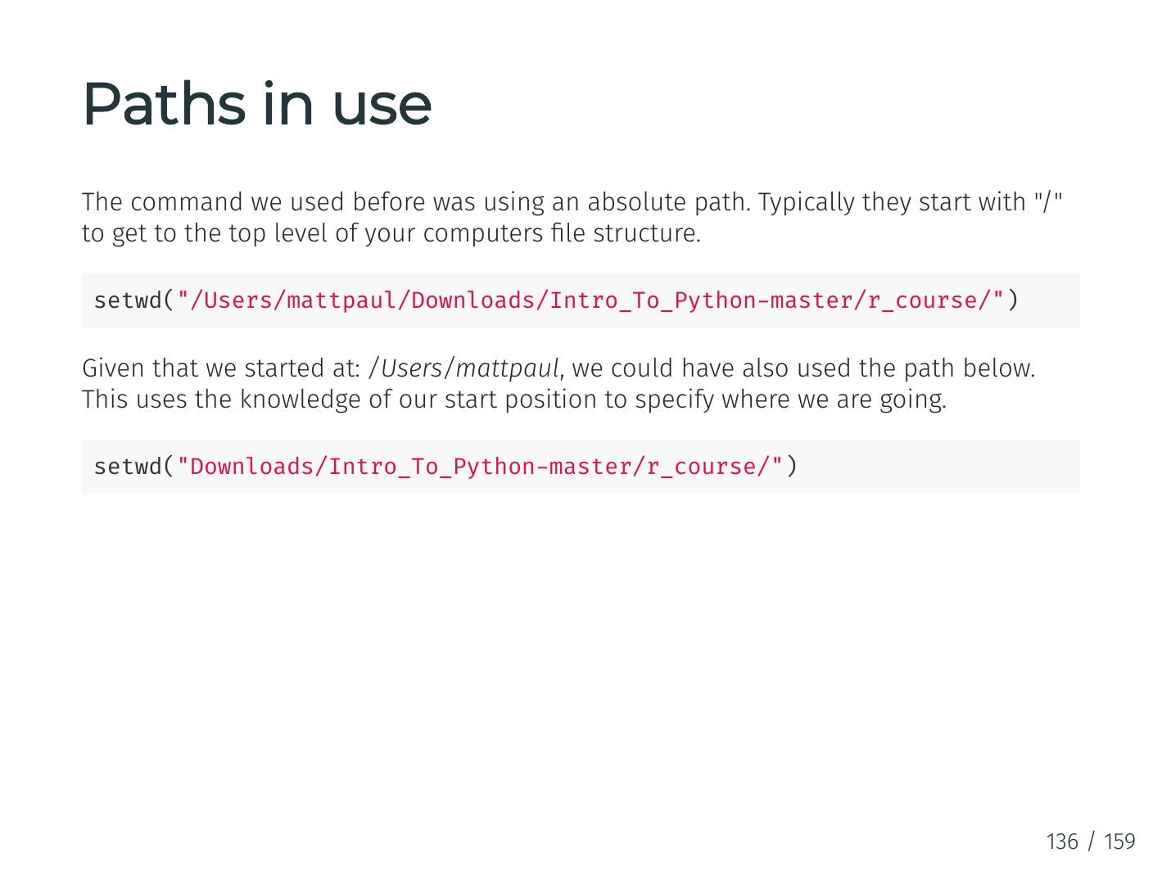

Slide 17
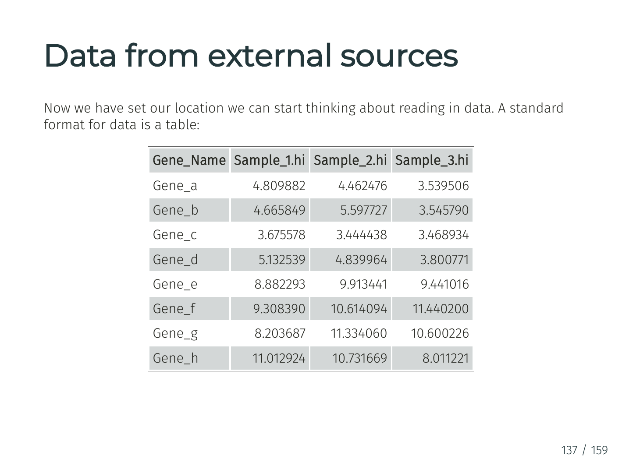

Slide 18
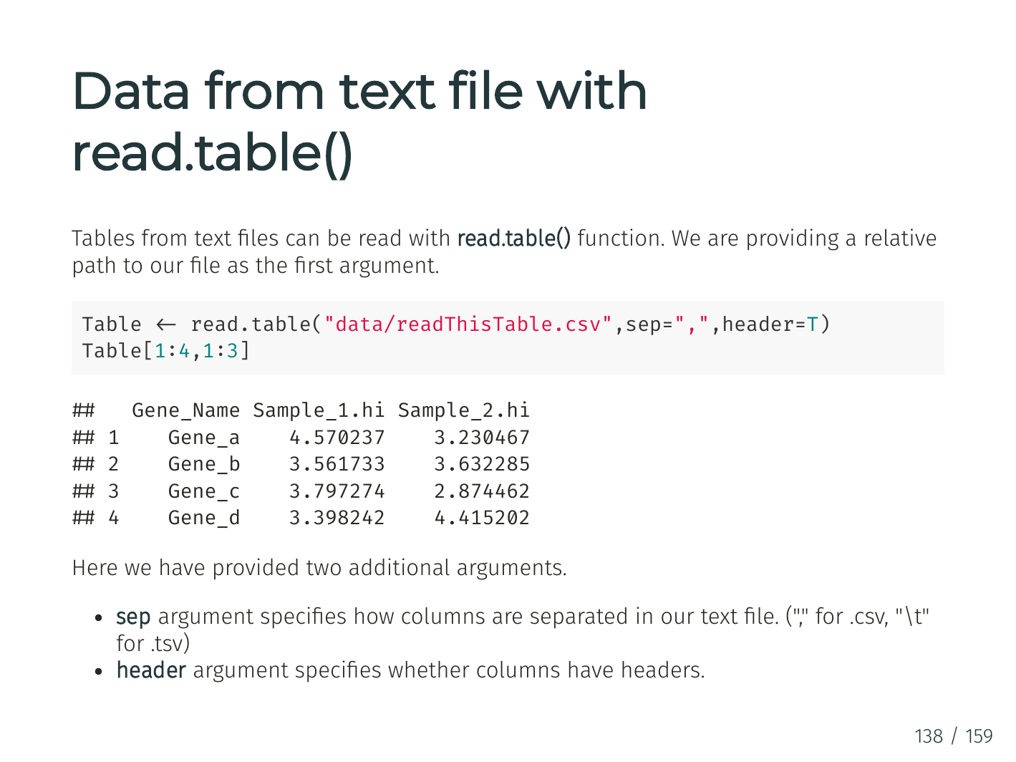

Slide 19
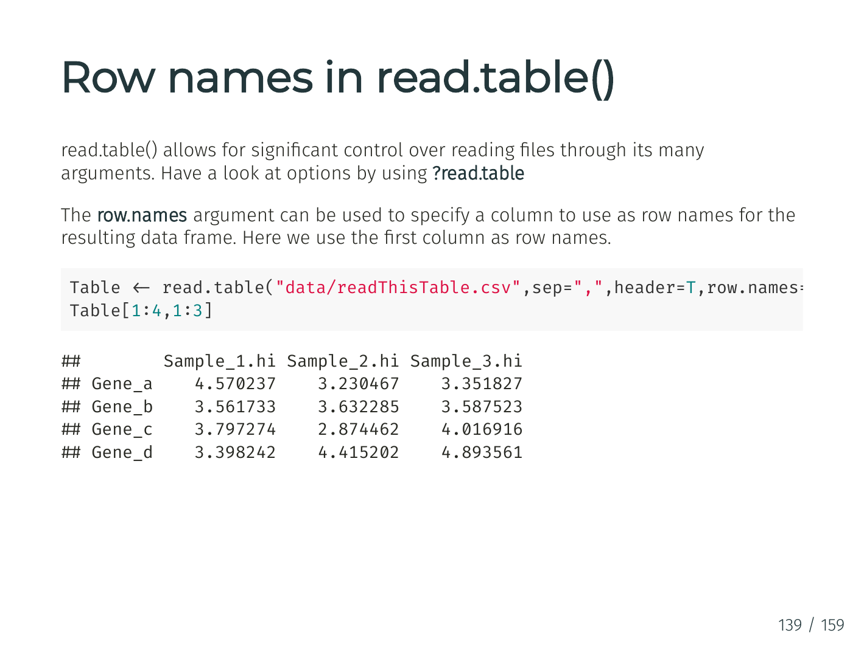

Slide 20
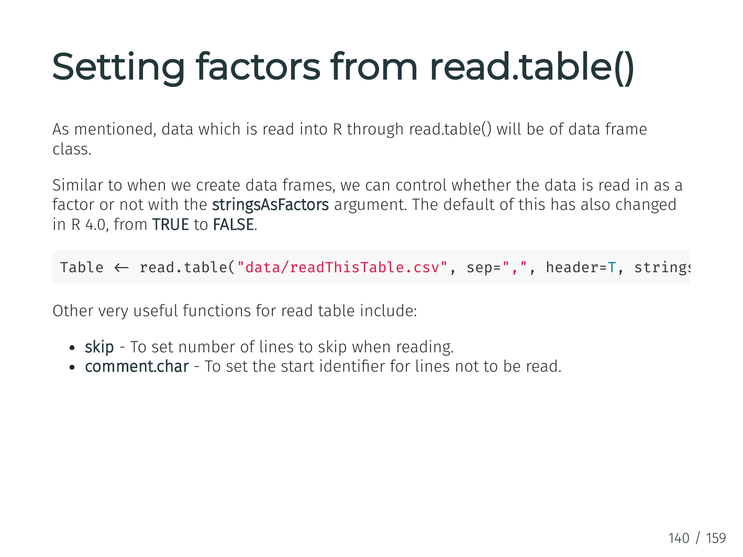

Slide 21
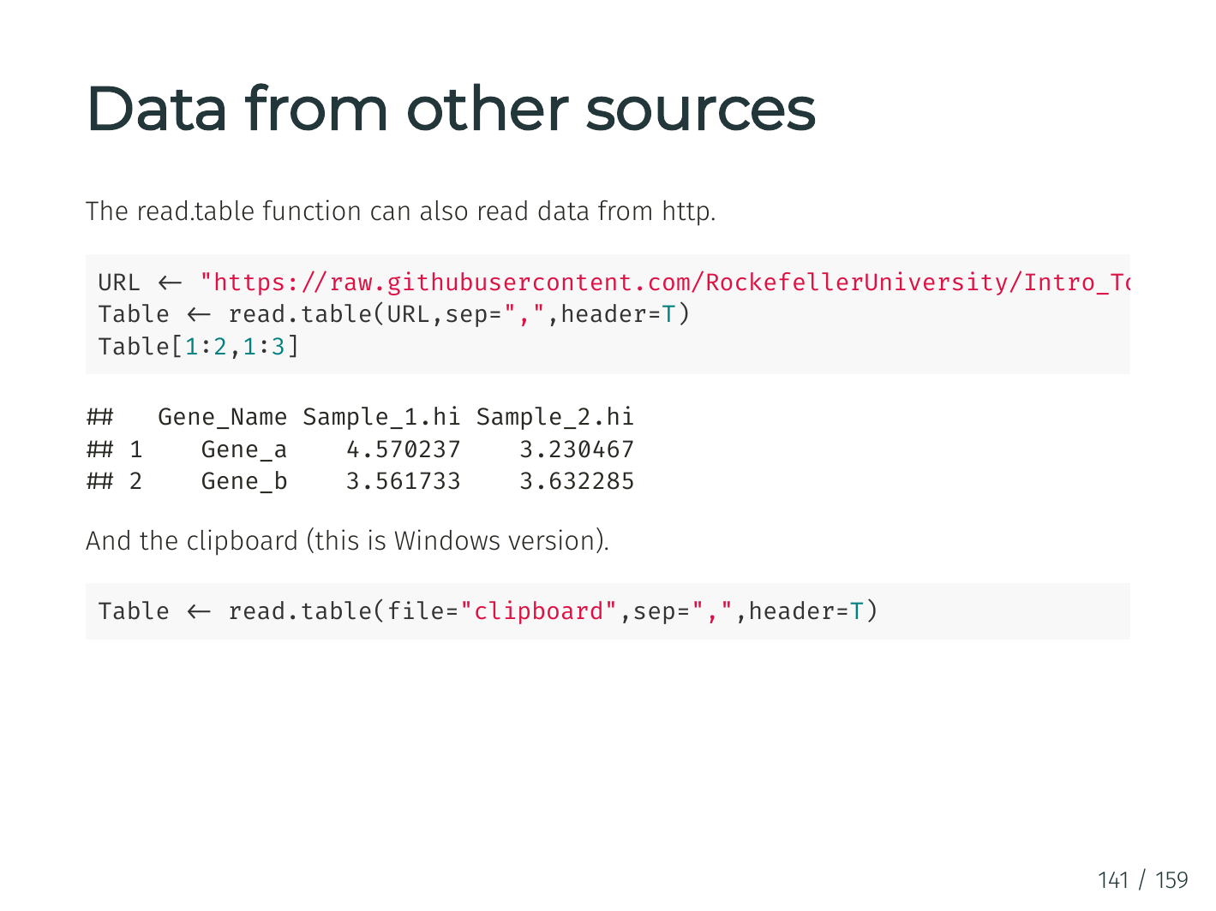

Slide 22
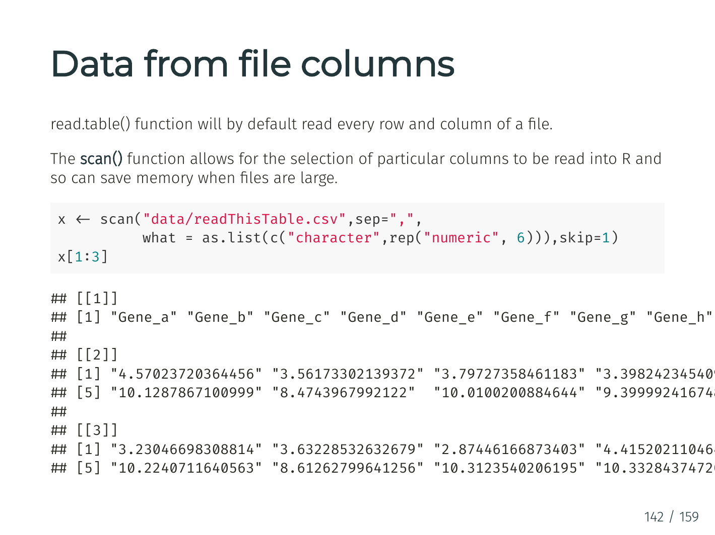

Slide 23
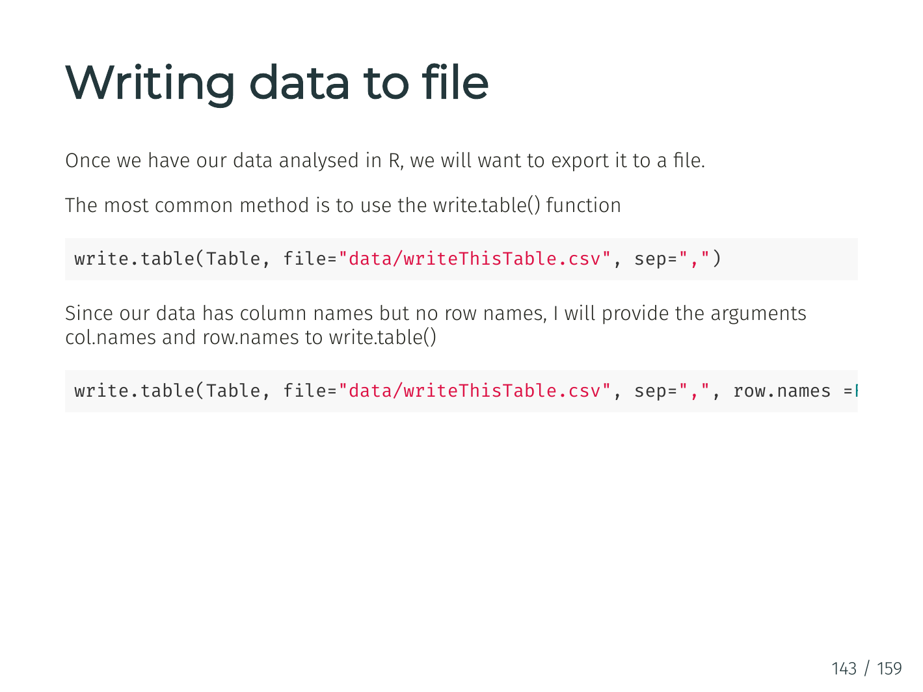

Slide 24
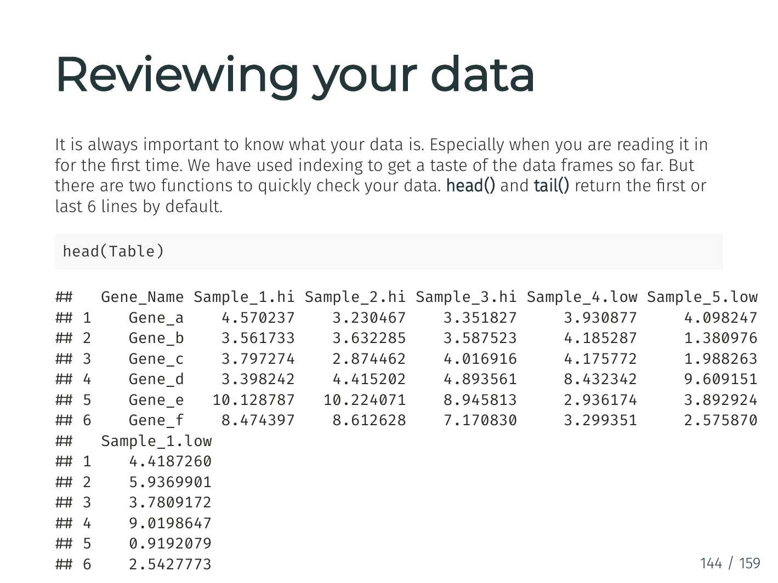

Slide 25
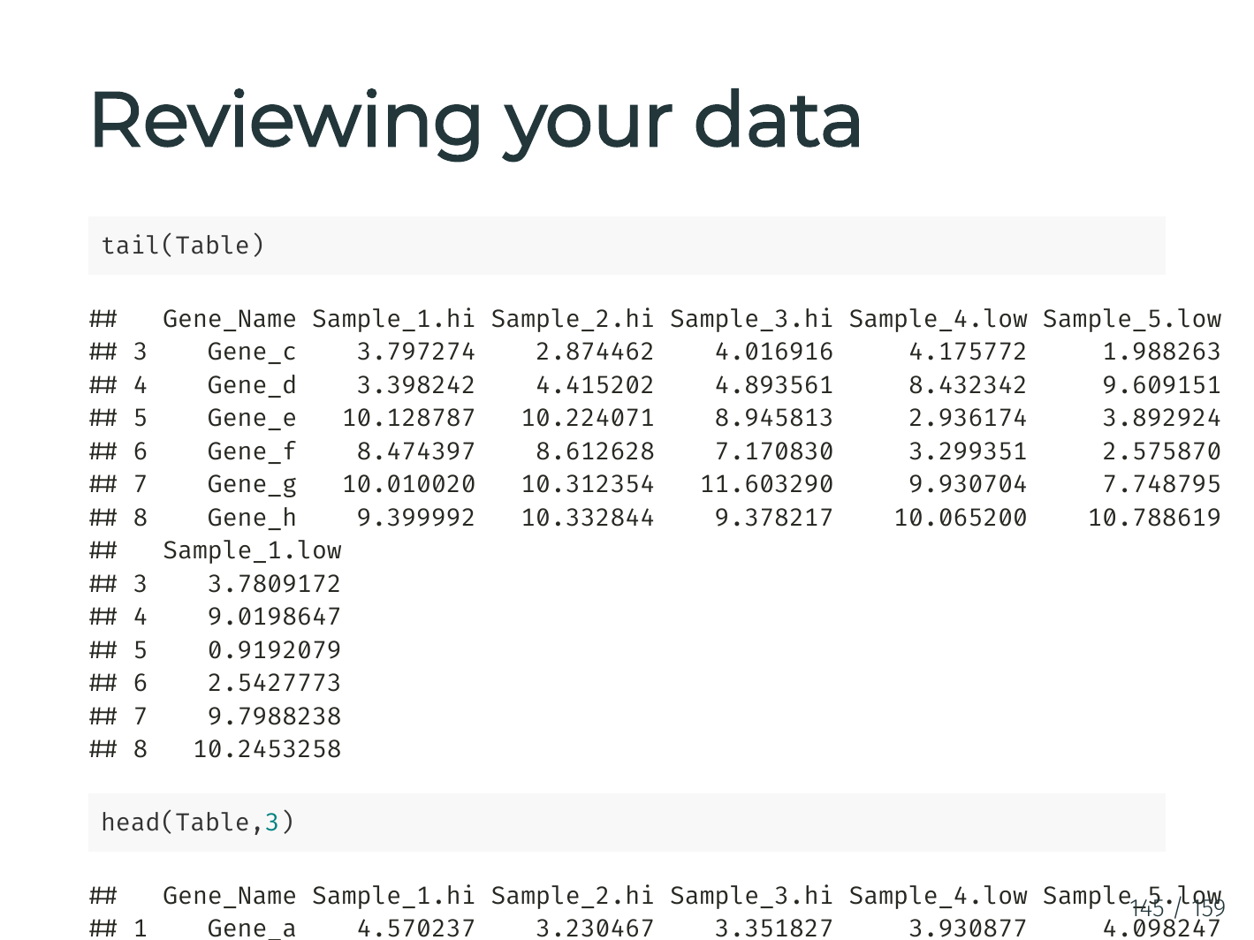

Slide 26
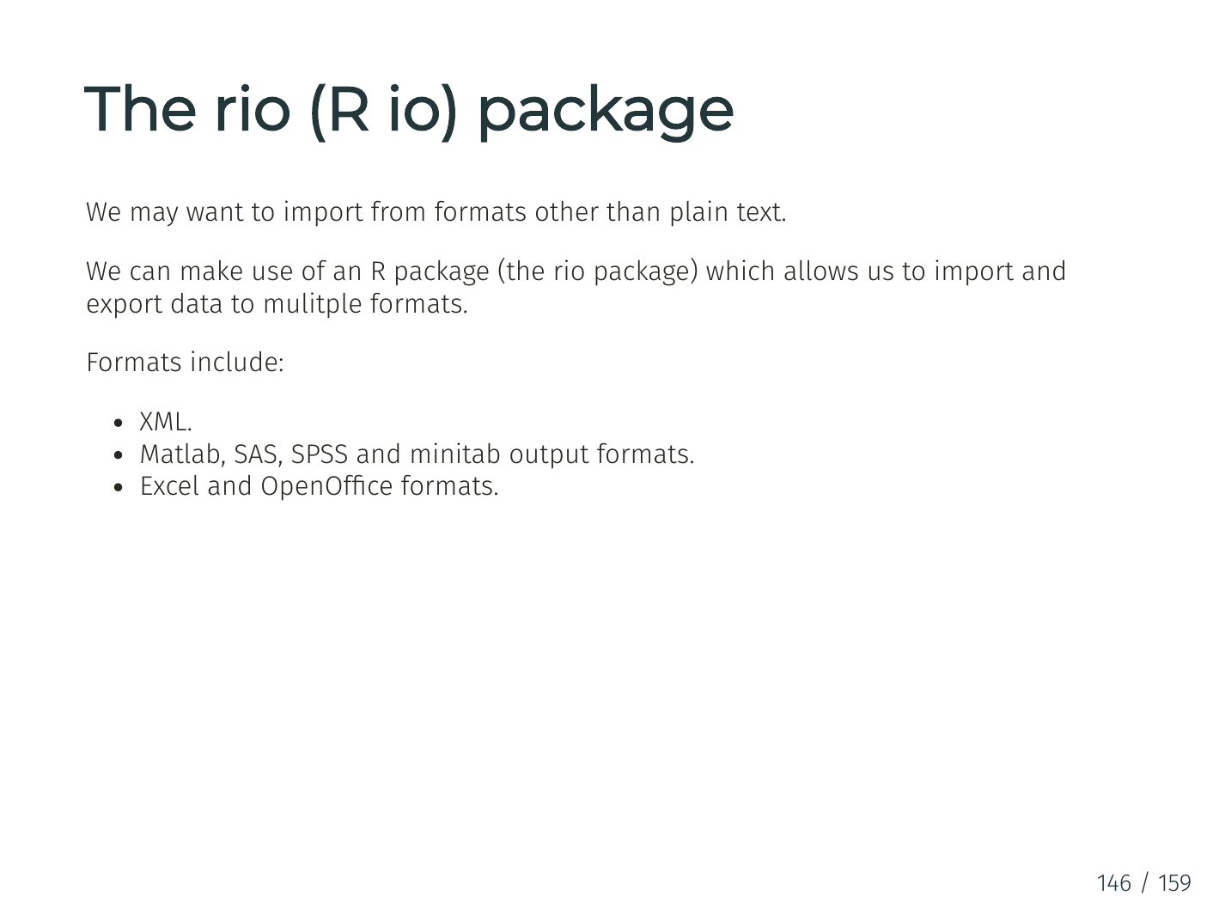

Slide 27
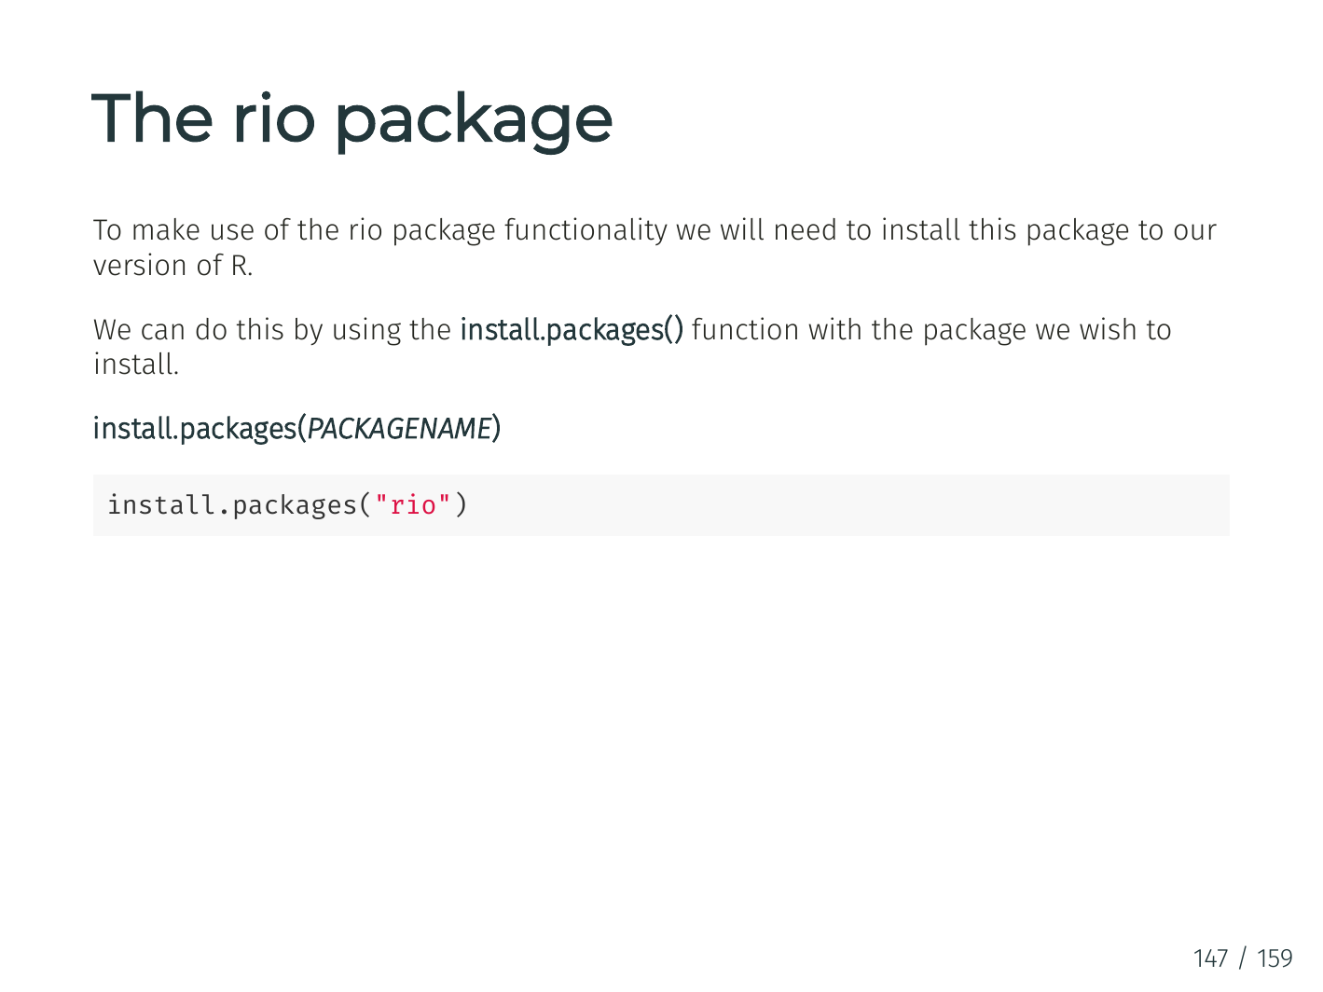

Slide 28
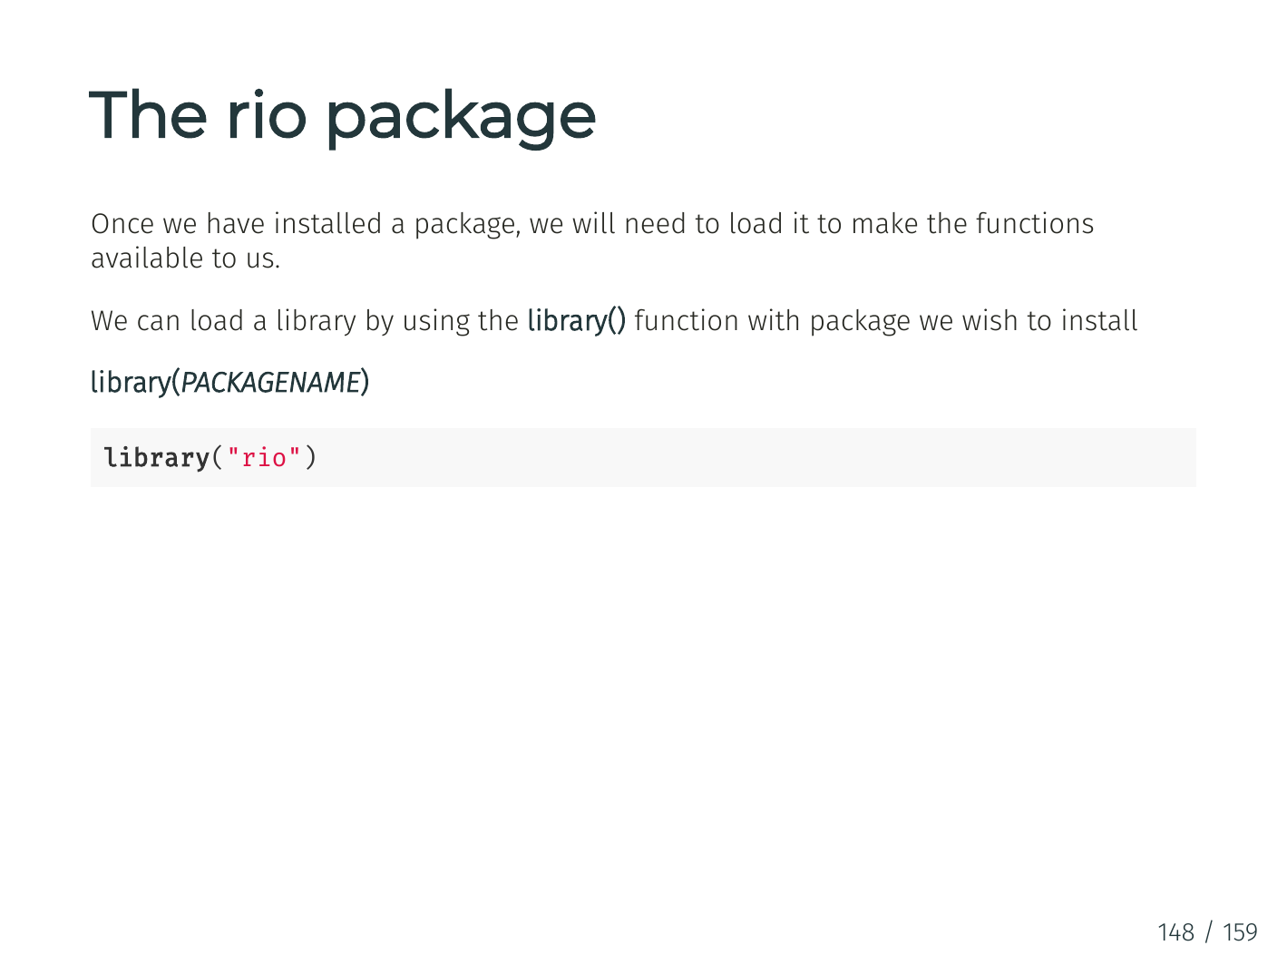

Slide 29
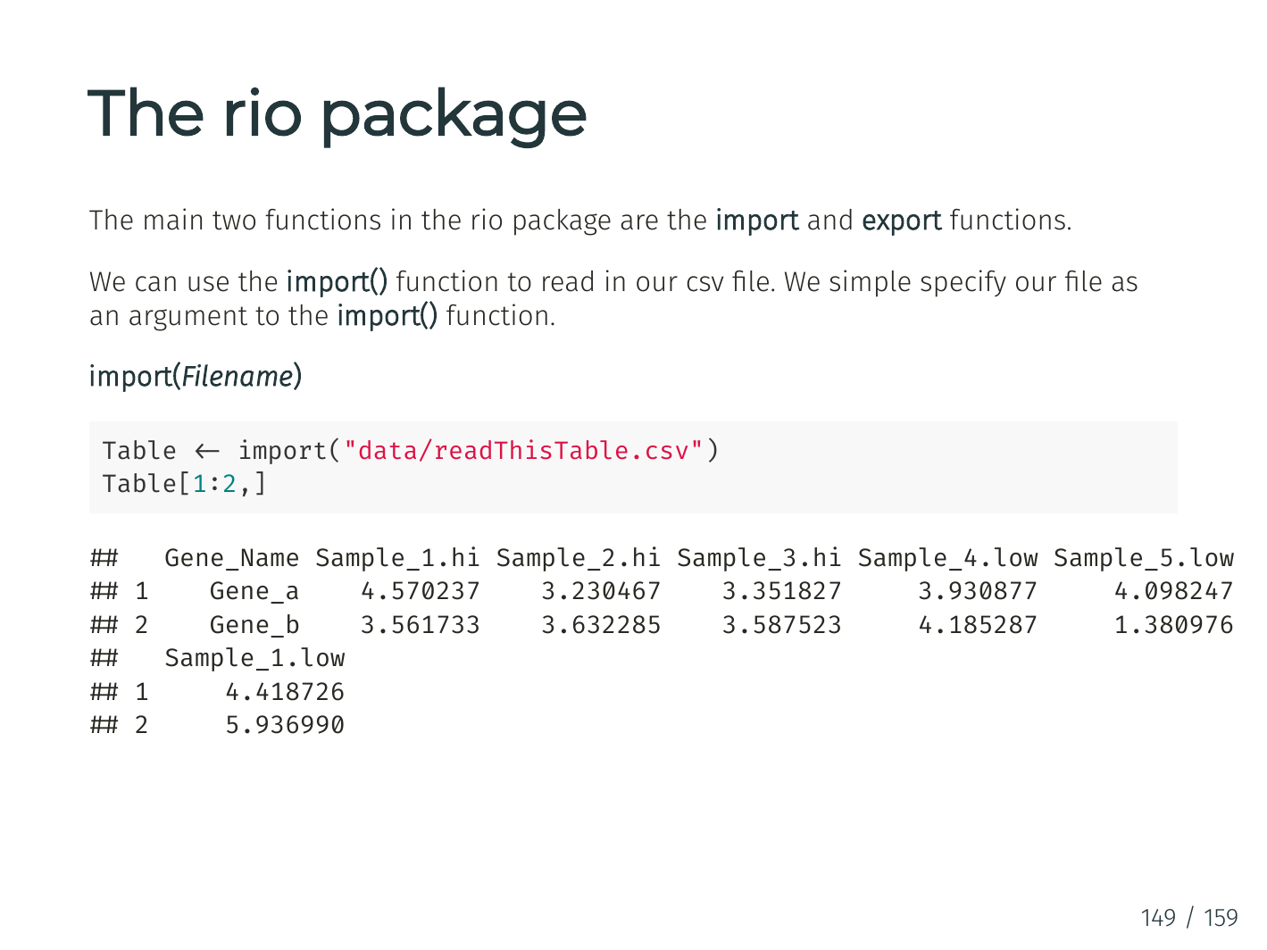

Slide 30
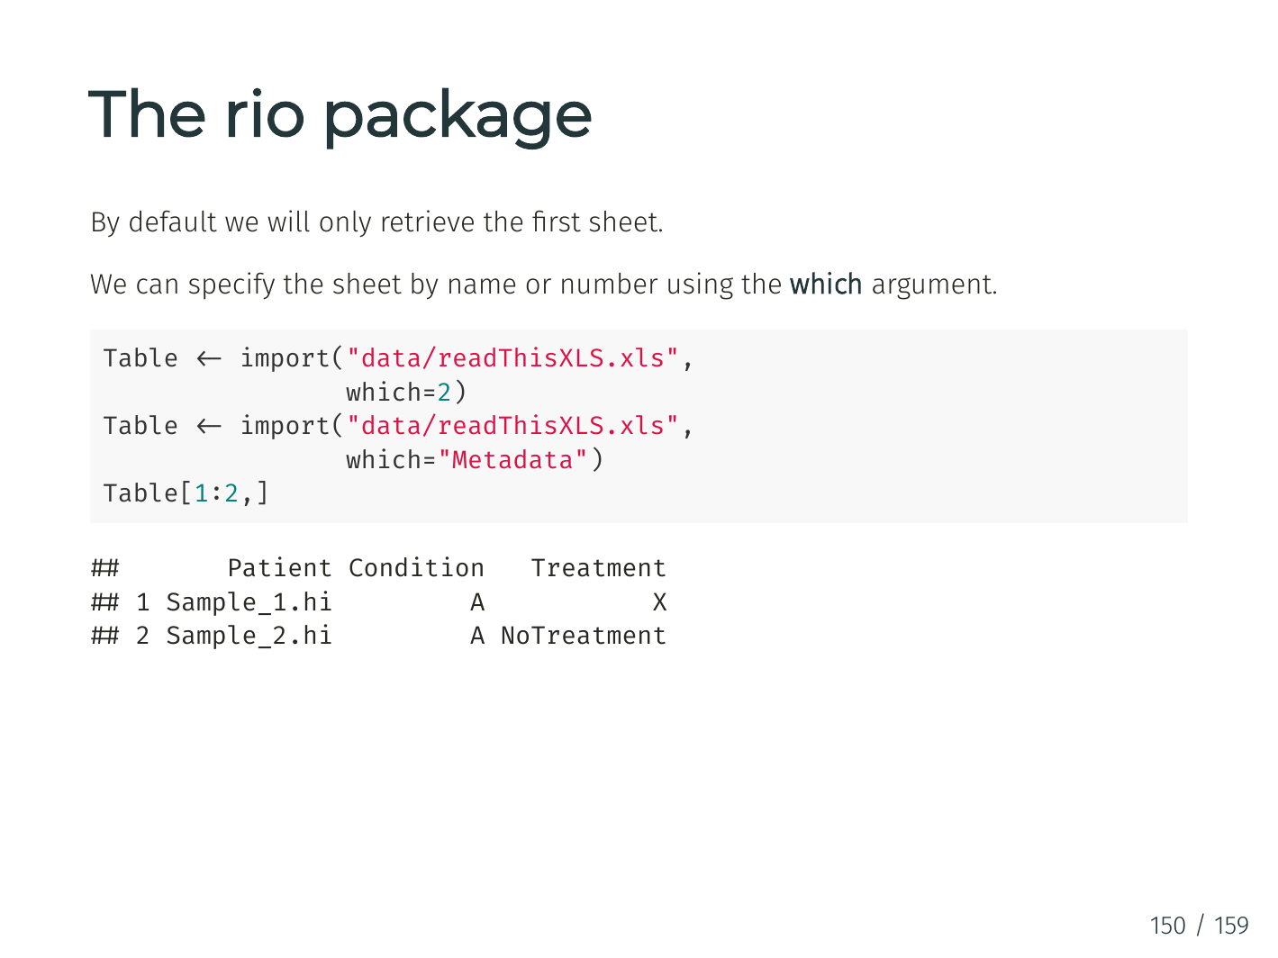

Slide 31
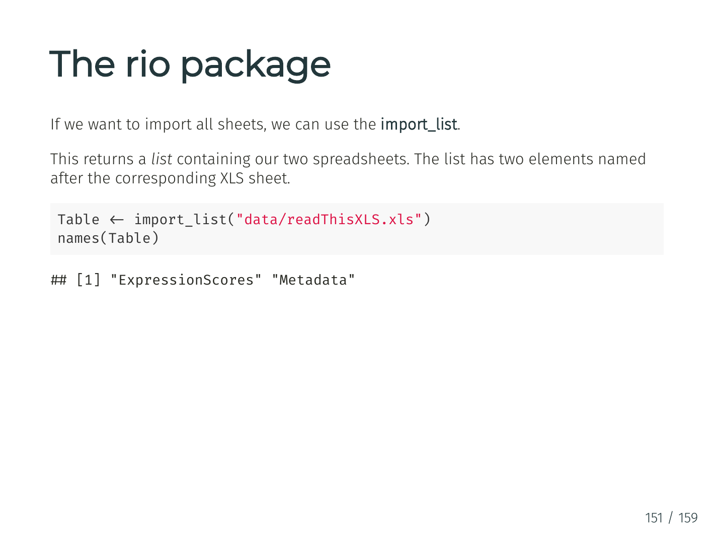

Slide 32
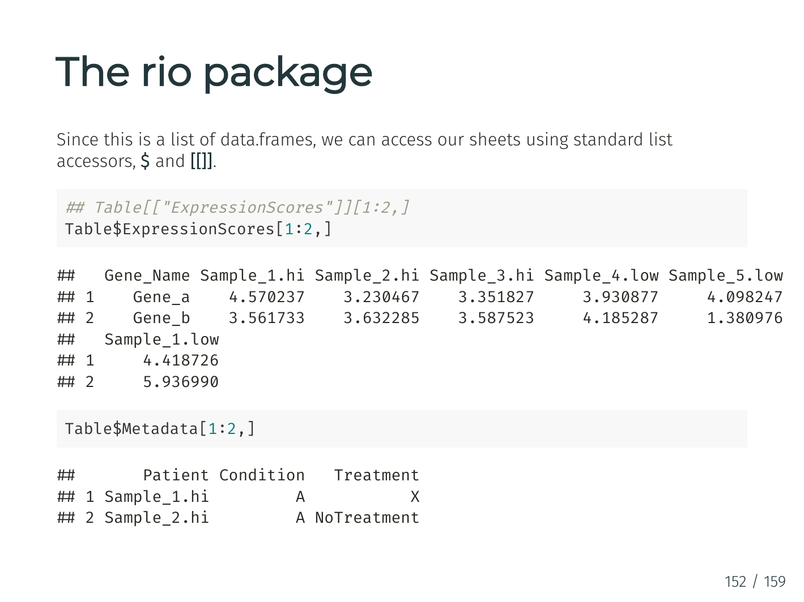

Slide 33
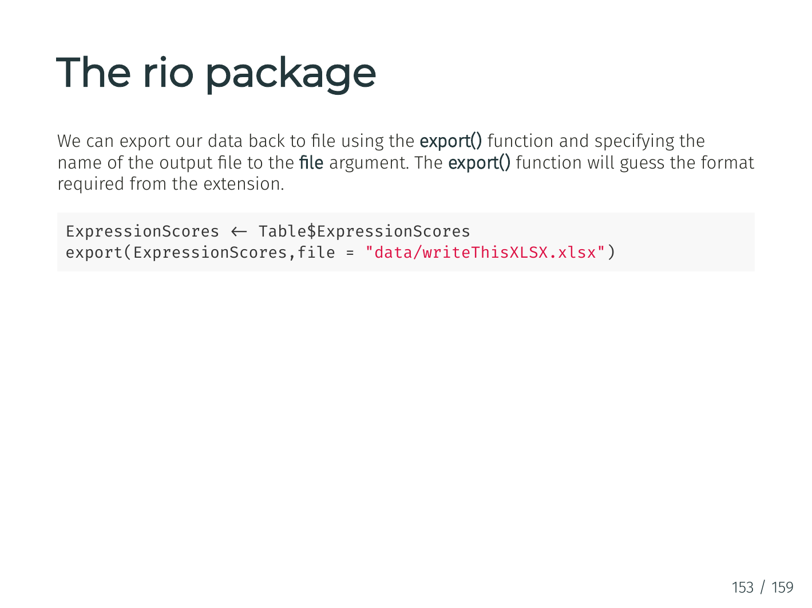

Slide 34
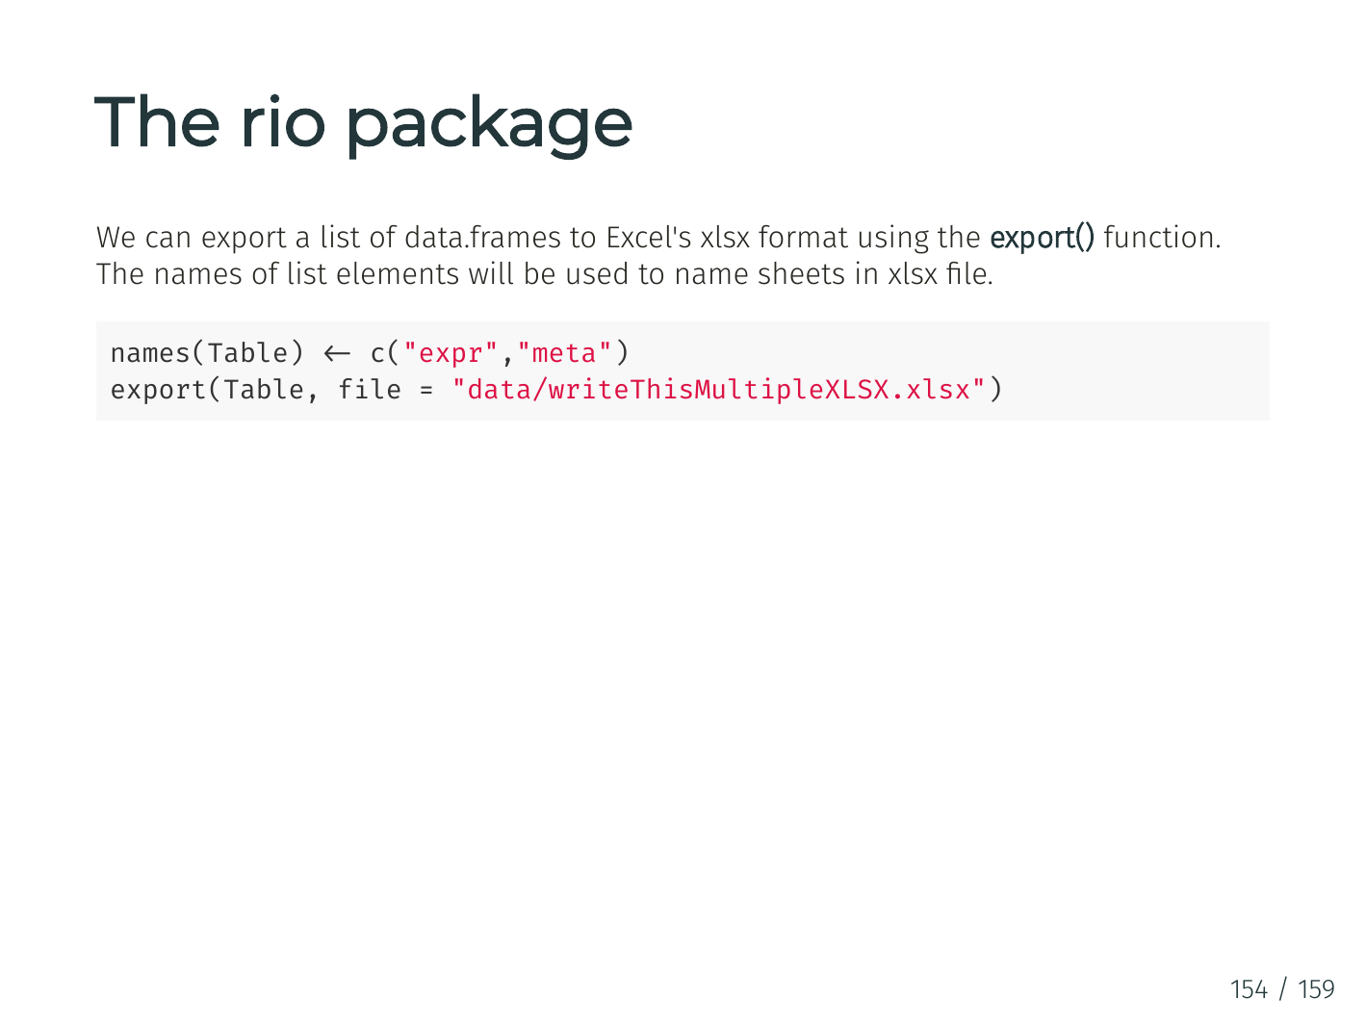

Slide 35
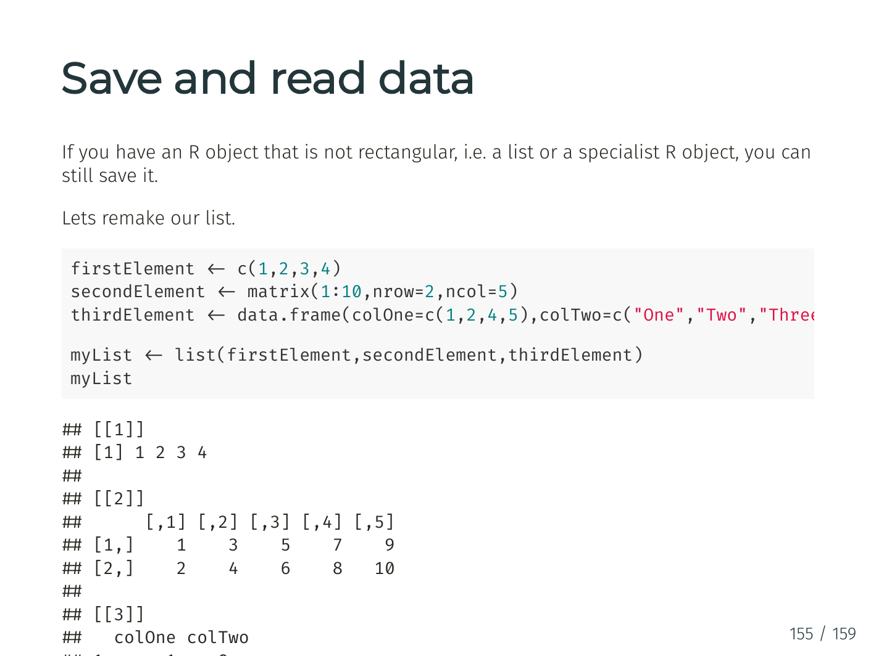

Slide 36
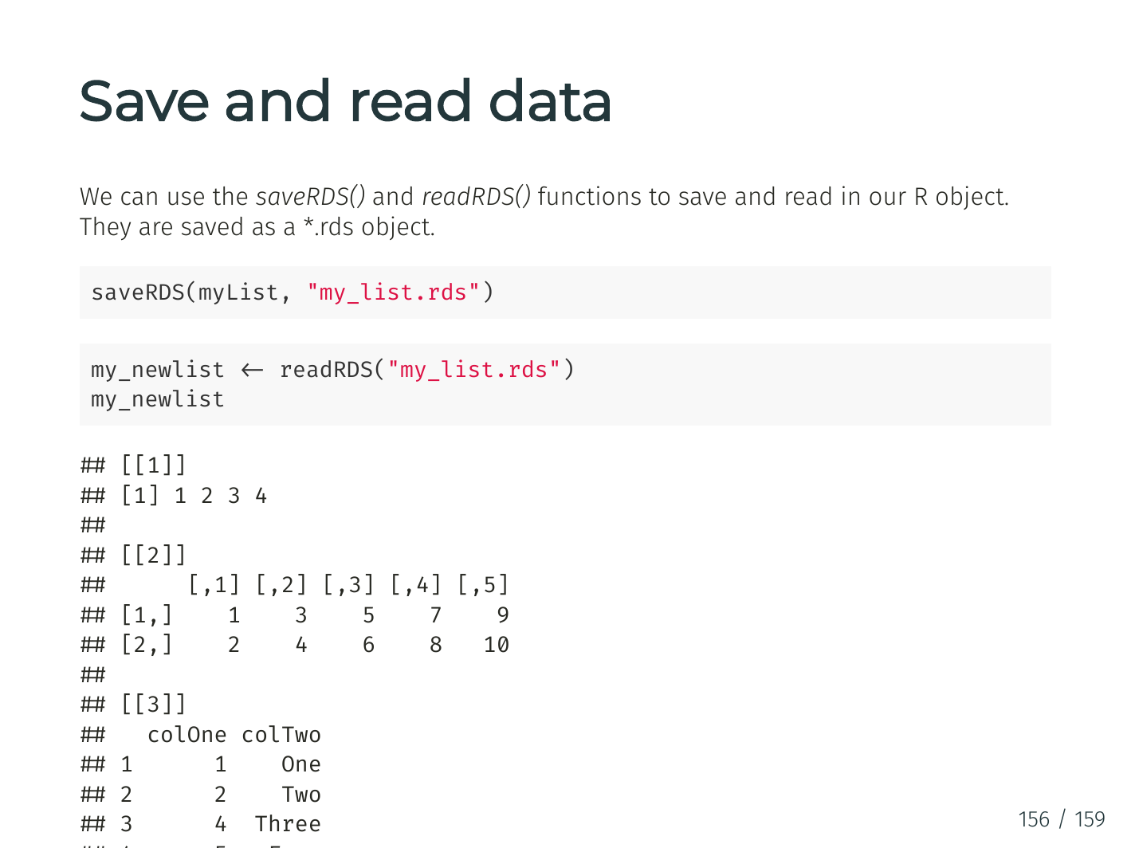

Slide 37
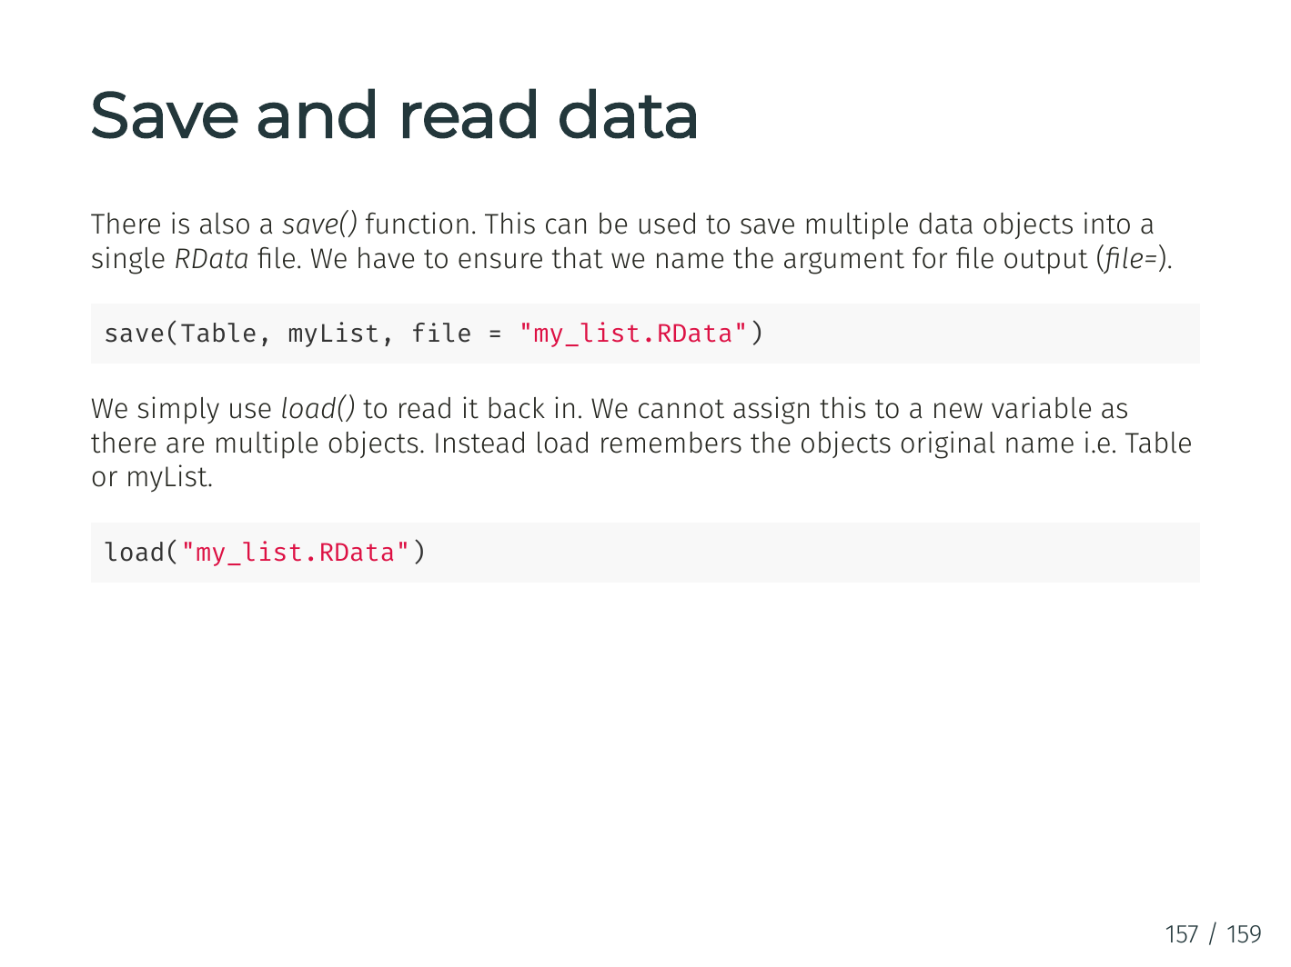

Slide 38
Tidy Data – Motivation (FANG Revenue Data)
Q1. Is the below table organized well for easy analysis?
Q2. In general, what’s a good way to organize/structure data?
# A tibble: 4 x 6
Ticker `Fiscal Year` Q1 Q2 Q3 Q4
<chr> <int> <dbl> <dbl> <dbl> <dbl>
1 AMZN 2018 51.0 52.9 56.6 72.4
2 FB 2018 12.0 13.2 13.7 16.9
3 GOOG 2018 31.1 32.7 33.7 39.3
4 NFLX 2018 3.70 3.91 4.00 4.19

Slide 39
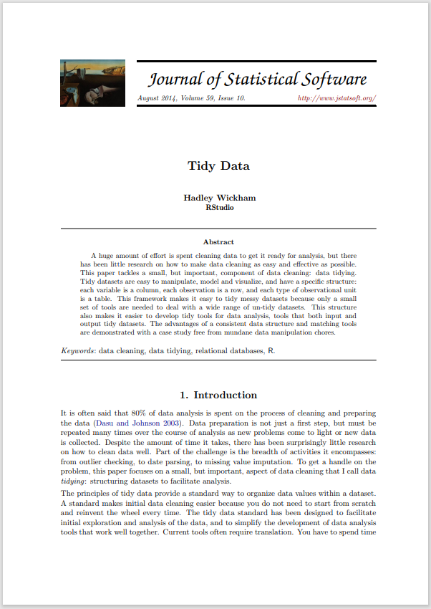
Tidy Data
A (One) way to organize tabular data
Definition
Each variable forms a column.
Each observation, or case, forms a row.
Each type of observational unit forms a table
Why tidy data
A great way to organize data for maintainability
Once in tidy data, it’s easy to use the toolset from tidyverse to manipulate them
http://vita.had.co.nz/papers/tidy-data.html
Notes:
“If you have a consistent data structure, it's easier to learn the tools that work with it because they have an underlying uniformity.”

Slide 40
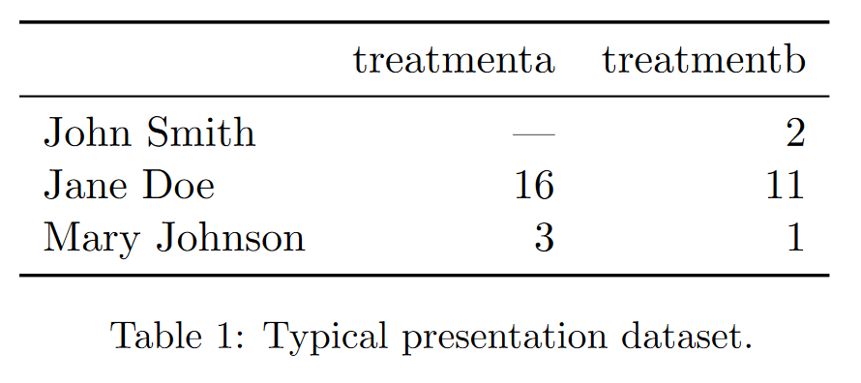
Messy Data – Example 1
http://vita.had.co.nz/papers/tidy-data.html

Slide 41
Messy Data – Example 1
http://vita.had.co.nz/papers/tidy-data.html
Notes:
value as in variable/column name; average results by a and b; average result of all and b; average result by person; in consistency;

Slide 42
Messy Data – Example 1 / Why is it Messy?
Values as column names
Hard to retrieve data and analyze them in a consistent way
how many treatments in total
get average result by person
get average result by treatment
get overall average result
http://vita.had.co.nz/papers/tidy-data.html
Notes:
value as in variable/column name; average results by a and b; average result of all and b; average result by person; in consistency;

Slide 43
Messy Data – Example 1 / Why is it Messy?
Values as column names
Hard to retrieve data and analyze them in a consistent way
how many treatments in total
get average result by person
get average result by treatment
get overall average result
http://vita.had.co.nz/papers/tidy-data.html
Notes:
value as in variable/column name; average results by a and b; average result of all and b; average result by person; in consistency;

Slide 44
Messy Data – Example 1 / Why is it Messy?
Values as column names
Hard to retrieve data and analyze them in a consistent way
how many treatments in total
get average result by person
get average result by treatment
get overall average result
http://vita.had.co.nz/papers/tidy-data.html
Notes:
value as in variable/column name; average results by a and b; average result of all and b; average result by person; in consistency;

Slide 45
Messy Data – Example 1 / Why is it Messy?
Values as column names
Hard to retrieve data and analyze them in a consistent way
how many treatments in total
get average result by person
get average result by treatment
get overall average result
http://vita.had.co.nz/papers/tidy-data.html
Notes:
value as in variable/column name; average results by a and b; average result of all and b; average result by person; in consistency;

Slide 46
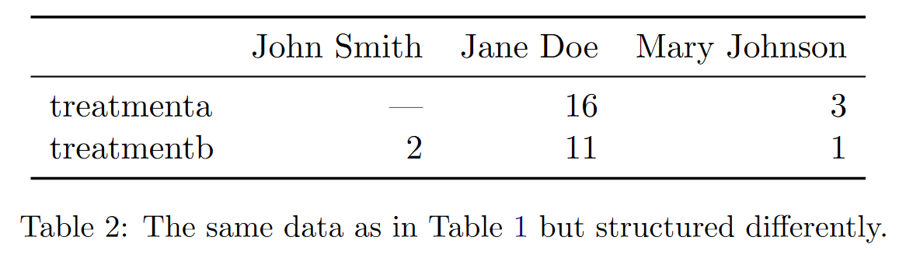
Messy Data – Example 2
http://vita.had.co.nz/papers/tidy-data.html

Slide 47
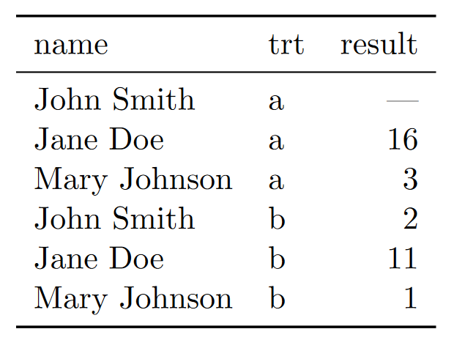
The Tidy Version
http://vita.had.co.nz/papers/tidy-data.html

Slide 48
The Tidy Version – Why is it Tidy
All column-wise operations
how many treatments in total
get average result by person
get average result by treatment
get overall average result
http://vita.had.co.nz/papers/tidy-data.html

Slide 49
Back to the FANG Revenue Data
# A tibble: 4 x 6
Ticker `Fiscal Year` Q1 Q2 Q3 Q4
<chr> <int> <dbl> <dbl> <dbl> <dbl>
1 AMZN 2018 51.0 52.9 56.6 72.4
2 FB 2018 12.0 13.2 13.7 16.9
3 GOOG 2018 31.1 32.7 33.7 39.3
4 NFLX 2018 3.70 3.91 4.00 4.19

Slide 50
From Messy to Tidy (One Example)

Slide 51
pivot_longer()
# A tibble: 3 x 3
name treatmenta treatmentb
<chr> <dbl> <dbl>
1 John Smith NA 2
2 Jane Doe 16 11
3 Mary Johnson 3 1
pivot_longer(df_messy, -name,
names_to = "treatment", values_to = "result")
https://tidyr.tidyverse.org/articles/pivot.html

Slide 52
pivot_longer()
# A tibble: 3 x 3
name treatmenta treatmentb
<chr> <dbl> <dbl>
1 John Smith NA 2
2 Jane Doe 16 11
3 Mary Johnson 3 1
pivot_longer(df_messy, -name,
names_to = "treatment", values_to = "result")
https://tidyr.tidyverse.org/articles/pivot.html

Slide 53
pivot_longer()
# A tibble: 3 x 3
name treatmenta treatmentb
<chr> <dbl> <dbl>
1 John Smith NA 2
2 Jane Doe 16 11
3 Mary Johnson 3 1
pivot_longer(df_messy, -name,
names_to = "treatment", values_to = "result")
https://tidyr.tidyverse.org/articles/pivot.html

Slide 54
pivot_longer()
# A tibble: 3 x 3
name treatmenta treatmentb
<chr> <dbl> <dbl>
1 John Smith NA 2
2 Jane Doe 16 11
3 Mary Johnson 3 1
pivot_longer(df_messy, -name,
names_to = "treatment", values_to = "result")
https://tidyr.tidyverse.org/articles/pivot.html

Slide 55
pivot_longer()
# A tibble: 3 x 3
name treatmenta treatmentb
<chr> <dbl> <dbl>
1 John Smith NA 2
2 Jane Doe 16 11
3 Mary Johnson 3 1
pivot_longer(df_messy, -name,
names_to = "treatment", values_to = "result")
https://tidyr.tidyverse.org/articles/pivot.html

Slide 56
pivot_longer() result
# A tibble: 6 x 3
name treatment result
<chr> <chr> <dbl>
1 John Smith treatmenta NA
2 John Smith treatmentb 2
3 Jane Doe treatmenta 16
4 Jane Doe treatmentb 11
5 Mary Johnson treatmenta 3
6 Mary Johnson treatmentb 1
https://tidyr.tidyverse.org/articles/pivot.html

Slide 57
The inverse transformation: pivot_wider()
name treatment result
<chr> <chr> <dbl>
1 John Smith a NA
2 Jane Doe a 16
3 Mary Johnson a 3
4 John Smith b 2
5 Jane Doe b 11
6 Mary Johnson b 1
pivot_wider(df_tidy,
names_from = treatment, values_from = result)
https://tidyr.tidyverse.org/articles/pivot.html

Slide 58
The inverse transformation: pivot_wider()
name treatment result
<chr> <chr> <dbl>
1 John Smith a NA
2 Jane Doe a 16
3 Mary Johnson a 3
4 John Smith b 2
5 Jane Doe b 11
6 Mary Johnson b 1
pivot_wider(df_tidy,
names_from = treatment, values_from = result)
https://tidyr.tidyverse.org/articles/pivot.html

Slide 59
The inverse transformation: pivot_wider()
name treatment result
<chr> <chr> <dbl>
1 John Smith a NA
2 Jane Doe a 16
3 Mary Johnson a 3
4 John Smith b 2
5 Jane Doe b 11
6 Mary Johnson b 1
pivot_wider(df_tidy,
names_from = treatment, values_from = result)
https://tidyr.tidyverse.org/articles/pivot.html

Slide 60
pivot_wider() result
# A tibble: 3 x 3
name a b
<chr> <dbl> <dbl>
1 John Smith NA 2
2 Jane Doe 16 11
3 Mary Johnson 3 1
https://tidyr.tidyverse.org/articles/pivot.html

Slide 61
Try Yourself: “Tidy up” the FANG revenue data
# A tibble: 16 x 4
Ticker `Fiscal Year` Quarter Revenue
<chr> <int> <chr> <dbl>
1 AMZN 2018 Q1 51.0
2 AMZN 2018 Q2 52.9
3 AMZN 2018 Q3 56.6
4 AMZN 2018 Q4 72.4
5 FB 2018 Q1 12.0
6 FB 2018 Q2 13.2
…
Load the raw “long” data from this URL: https://tdmdal.github.io/r-tutorial-202021-winter/data/fang_2018.csv

Slide 62
Many Ways of Being Messy :(
Messy datasets have 5 common problems (Wickham, 2014)
Column headers are values, not variable names.
Multiple variables are stored in one column.
Variables are stored in both rows and columns.
Multiple types of observational units are stored in the same table.
A single observational unit is stored in multiple tables.
http://vita.had.co.nz/papers/tidy-data.html

Slide 63
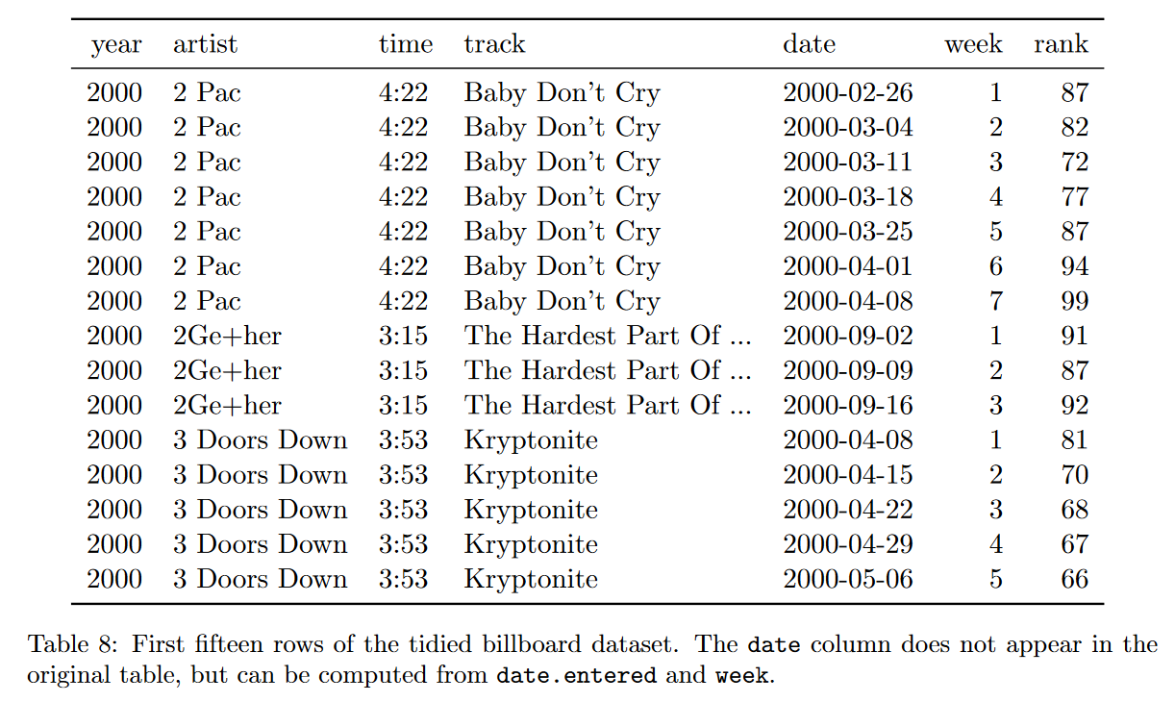
Messy Data – Example 3
http://vita.had.co.nz/papers/tidy-data.html

Slide 64
Messy Data – Example 3
http://vita.had.co.nz/papers/tidy-data.html

Slide 65
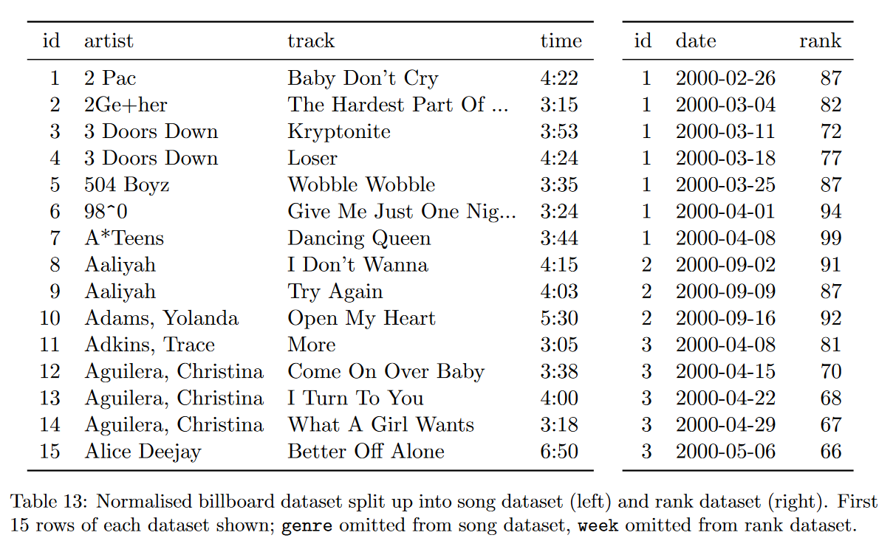
The Tidy Version
http://vita.had.co.nz/papers/tidy-data.html

Slide 66






Tidy Data and Its Eco-system
Tidyverse
“an opinionated collection of R packages designed for data science”
“All packages share an underlying design philosophy, grammar, and data structures.”
Other tools in the eco-system (especially for finance)
tidyquant, a package for quantitative finance
tidyvert, a set of tidy tools for time series
Forecasting: Principles and Practice (3ed), a free book using this toolset

Slide 67
Plan
“Data Scientists spend up to 80% of the time on data cleaning and 20 percent of their time on actual data analysis”
-- ?????
Tidy Data
Data manipulation (a continuation)
summarise() and group_by()
_join() datasets
Again, we will focus on basics, underlying principles, and best practices

Slide 68
Data manipulation: dplyr()
Filter observations: filter()
Select variables: select()
Reorder rows: arrange()
Create new variables: mutate()
Collapse column values to a single summary: summarise()
Group by: group_by()

Slide 69
The Employees Table
> employees %>% select(FirstName, LastName, Country)
# A tibble: 9 x 3
FirstName LastName Country
<chr> <chr> <chr>
1 Nancy Davolio USA
2 Andrew Fuller USA
3 Janet Leverling USA
4 Margaret Peacock USA
5 Steven Buchanan UK
…

Slide 70
Count Number of Employees By Country (1)
> employees %>% select(FirstName, LastName, Country) %>%
group_by(Country)
# A tibble: 9 x 3
# Groups: Country [2]
FirstName LastName Country
<chr> <chr> <chr>
1 Nancy Davolio USA
2 Andrew Fuller USA
3 Janet Leverling USA
…

Slide 71
Count Number of Employees By Country (2)
> employees %>% select(FirstName, LastName, Country) %>%
group_by(Country) %>%
summarise(count = n())
# A tibble: 2 x 2
Country count
<chr> <int>
1 UK 4
2 USA 5

Slide 72
Count Number of Employees By Country (3)
> employees %>% select(FirstName, LastName, Country) %>%
group_by(Country) %>%
summarise(count = n()) %>%
arrange(desc(count))
# A tibble: 2 x 2
Country count
<chr> <int>
1 USA 5
2 UK 4

Slide 73
More on Data Aggregation
summarise() works with many aggregation functions
Aggregation function: n input -> 1 output
e.g. mean(), median(), min(), max(), first(), last(), n_distinct(), …
There are also Windows functions (useful for time series data)
Windows functions: n input -> n output
aggregation variations: cumsum(), cummean(),…
ranking and ordering: rank(), percent_rank(),…
offsets: lead(), lag(),…
https://dplyr.tidyverse.org/reference/summarise.html https://dplyr.tidyverse.org/articles/window-functions.html

Slide 74
Plan
“Data Scientists spend up to 80% of the time on data cleaning and 20 percent of their time on actual data analysis”
-- ?????
Tidy Data
Data manipulation (a continuation)
summarise() and group_by()
_join() datasets
Again, we will focus on basics, underlying principles, and best practices

Slide 75
Motivation: Relation between Datasets/Tables

Slide 76
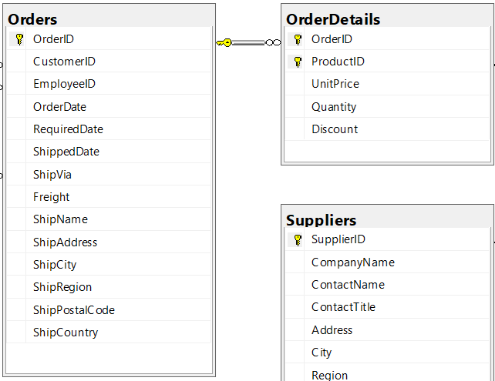
Relation between Datasets/Tables – Zoom In

Slide 77
Relation between Datasets/Tables – Zoom In
Primary key

Slide 78
Relation between datasets/tables – Zoom In
Primary key
Foreign key

Slide 79
Relation between datasets/tables – Zoom In
Primary key
Foreign key
1-to-Many Relationship

Slide 80
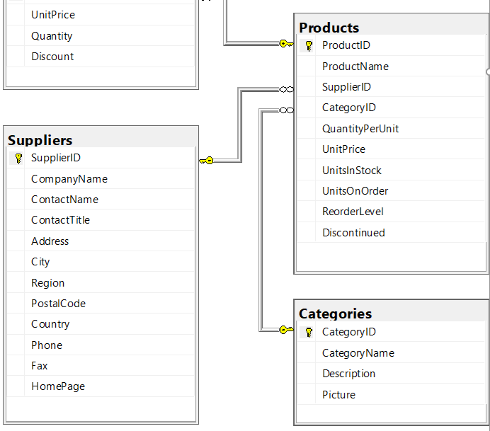
Relation between Tables – Another Example

Slide 81
Join – Inner Join
Table1
Table2
pk | t1c1
1 | a
2 | b
fk | t2c1
1 | c
1 | d
3 | e
Table1
Table2
pk | t1c1 | t2c1
1 | a | c
1 | a | d
inner_join(Table1, Table2, by = c("pk" = "fk"))

Slide 82
Join – Left (Outer) Join
Table1
Table2
pk | t1c1
1 | a
2 | b
fk | t2c1
1 | c
1 | d
3 | e
Table1
Table2
pk | t1c1 | t2c1
1 | a | c
1 | a | d
2 | b | NA
left_join(Table1, Table2, by = c("pk" = "fk"))

Slide 83
Join - Left (Outer) Join With Exclusion
Table1
Table2
pk | t1c1
1 | a
2 | b
fk | t2c1
1 | c
1 | d
3 | e
Table1
Table2
pk | t1c1 | t2c1
2 | b | NA
Table1 %>%
left_join(Table2, by = c("pk" = "fk")) %>%
filter(is.na(t2c1))

Slide 84
More on Join Variations (learn them yourself)
More join variation illustrations in the next few slides
right join, full join, …
Read the “two-table verbs” vignette (in the dplyr package doc)
https://dplyr.tidyverse.org/articles/two-table.html
Read the reference (see the “two table verbs” section)
https://dplyr.tidyverse.org/reference/index.html
For data manipulation tasks in general
reading dplyr related articles are a good start, https://dplyr.tidyverse.org/articles/

Slide 85
Join – Right (Outer) Join*
Table1
Table2
pk | t1c1
1 | a
2 | b
fk | t2c1
1 | c
1 | d
3 | e
Table1
Table2
pk | t1c1 | t2c1
1 | a | c
1 | a | d
3 | NA | e
right_join(Table1, Table2, by = c("pk" = "fk"))
Note: can use left_join as well.

Slide 86
Join - Right (Outer) Join With Exclusion*
Table1
Table2
Table1
Table2
pk | t1c1
1 | a
2 | b
fk | t2c1
1 | c
1 | d
3 | e
pk | t1c1 | t2c1
3 | NA | e
Table1 %>%
right_join(Table2, by = c("pk" = "fk")) %>%
filter(is.na(t1c1))

Slide 87
Join – Full Outer Join
Table1
Table2
pk | t1c1
1 | a
2 | b
fk | t2c1
1 | c
1 | d
3 | e
Table1
Table2
pk | t1c1 | t2c1
1 | a | c
1 | a | d
2 | b | NA
3 | NA | e
full_join(Table1, Table2, by = c("pk" = "fk"))

Slide 88
Join – Full Outer Join With Exclusion
Table1
Table2
pk | t1c1
1 | a
2 | b
fk | t2c1
1 | c
1 | d
3 | e
Table1
Table2
pk | t1c1 | t2c1
2 | b | NA
3 | NA | e
Table1 %>%
full_join(Table2, by = c("pk" = "fk")) %>%
filter(is.na(t1c1) | is.na(t2c1))

